Slide 1
Ransomware address detection
Sanjay Mahto

Slide 2
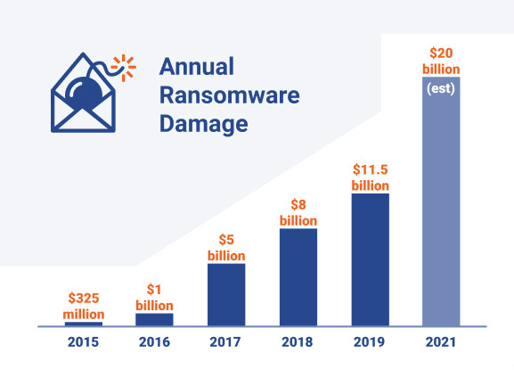
Background
Ransomware attacks started around mid 20’s
It is a continues threat since then and increasing every year

Slide 3
Problem Statement
Trying to predict if a bitcoin address is potentially a part of ransomware attacks provided the features
Goal is to warn the users before doing any transections in bitcoin
It could be also integrated into bitcoin wallets to warn the users while do the transaction.

Slide 4
Data Wrangling
Data acquired from UCI machine learning repository
Consists over 10 Million data points
We have categorized data into white and black
Utilizing 140K data including black and white
Relabeling, Random selection, Splitting, Appending, Typecasting has been done in data cleaning process

Slide 5
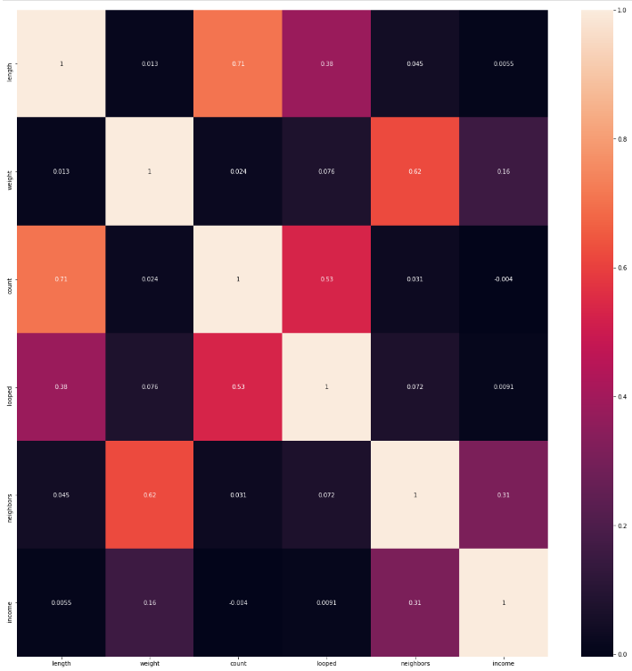
(Exploratory data analysis)EDA
Data was analyzed using various visualization technique.
Correlation matrix (Heat map)

Slide 6
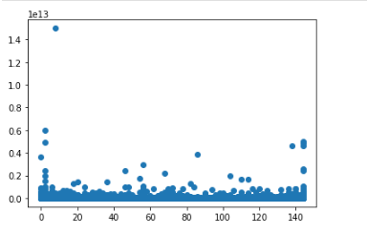
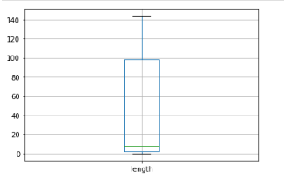
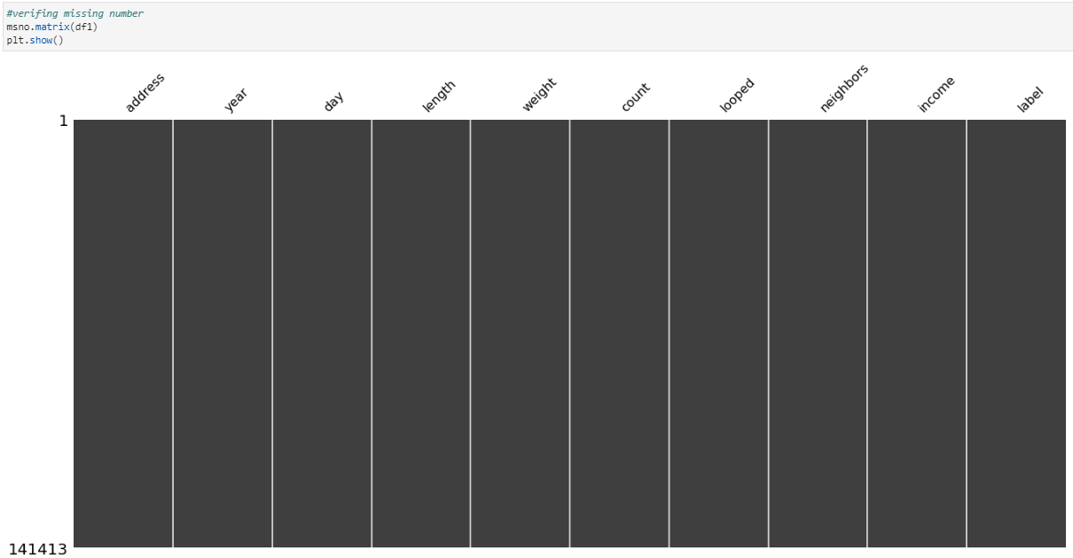
EDA..

Slide 7
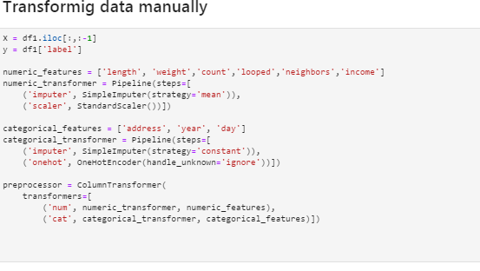

Feature Engineering
Two types of feature engineering is used
Manual Feature engineering
Automated Feature Engineering
Automated feature engineering

Slide 8
Modeling
Three different models with two different hyper tuning methods has been used
Logistic Regression (Max 89.4% Accuracy with grid search)
Random Forest Classifier (Max 92.5% Accuracy with random search)
Support Vector Classifier (SVC) (Max 90.6% Accuracy with random search)

Slide 9
Conclusion
Random forest is a winner so far with 92.5% accuracy
We can keep modeling it with other advance classifier
We can also use stack of models and try to achieve better accuracy
We can also use deep learning and try to achieve the better accuracy

Slide 10
Thank you

